Slide 1
Intro to Git and Github
January 2016

Slide 2
The purpose of today’s class
Today we will learn about what open source software are, git and GitHub are, what the difference between the two are. We will commit code in a few different ways our GitHub Repositories.

Slide 3
Contact
Jessica Garson
Jessica.Garson@gmail.com
Jessica.Garson@bm.com
Twitter: @jessicagarson

Slide 4
What will we accomplish today
Create our Github accounts and Cloud 9 accounts
Develop a clear understanding of what open source software is
Know what the difference between Git and Github are
Create a few markdown files
Clone and fork repos
Create repositories
Commit our code in a few different ways including the command line
Submit pull requests

Slide 5
Why I decided to teach this class
This content was very hard for me master
The language of git can be complex and tricky at first but once you start to understand it – it’s pretty easy to understand
If this is something you enjoy doing, you should consider becoming a software engineer

Slide 6
Introductions
Name
Favorite movie
What brings you here today

Slide 7

My Story

Slide 8

What is git

Slide 9

What is GitHub

Slide 10

These tool help us work together smarter

Slide 11

Open Source Software

Slide 12
Let’s take a look around GitHub
We will check out a few repositories and play around for a minute

Slide 13
There are a few ways to add files to GitHub
Manually
The command line
Graphical Interfaces
GitHub has their own one
SourceTree
I used the command line tools built into PyCharm sometimes – other editors have git interfaces

Slide 14
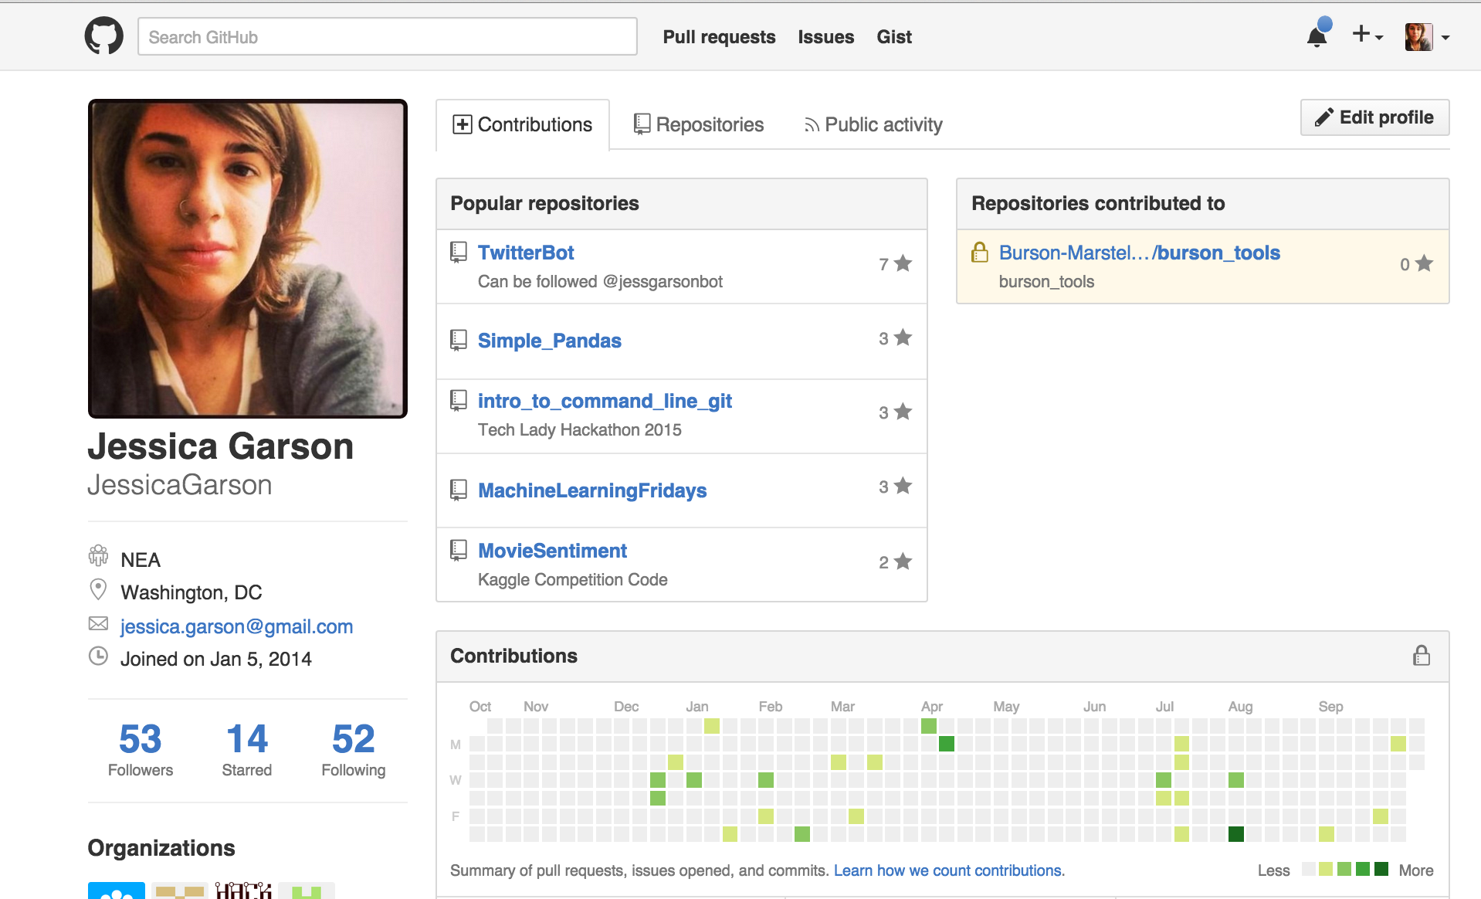
Let’s make our own GitHub profile www.github.com

Slide 15
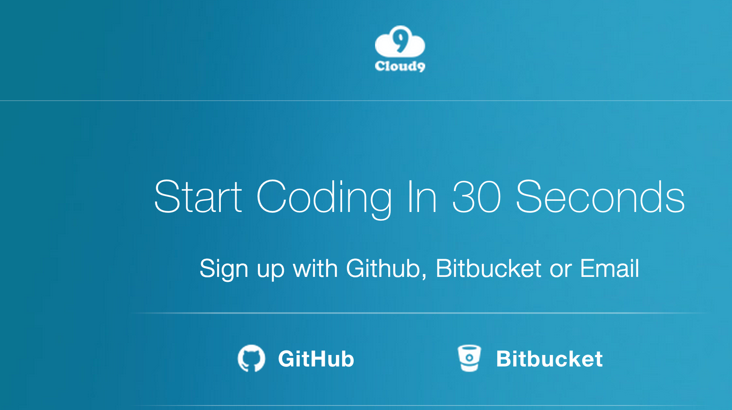
Let’s Create Our Cloud 9 account https://c9.io/web/sign-up/free

Slide 16
Let’s build a house
As a class we will separate into groups and each draw a different room of house.
Each group checkout a room of the house
When we are done we will leave our rooms in the staging location
As a class we will piece together the house

Slide 17
Lets debrief on this
How did we work together in this activity?
How does this activity teach us about Git and GitHub?
Did this workflow help is in managing how we were working together on this activity

Slide 18
Fun fact
The terms repo and repository are typically used interchangeably

Slide 19
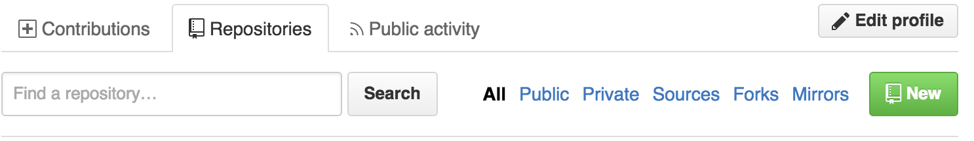
Let’s Create Our First Repository
Let’s go into the GitHub and create our first repository
From there we will use to text command and the editor in cloud 9 to create a text file inside of cloud 9 and commit the file by cutting and pasting the file.

Slide 20
Let’s create a text file inside of cloud 9
We will use the touch command to create new files from the command line
From there we will commit this file to our git repository using the following commands
git add newfile.txt
git commit – m “adding new file”
git push origin master

Slide 21
The difference between a clone and a fork
Cloning copies the repository into our own machine
Forking allows us to have our own copy on GitHub – we can later compare between forks and changes to the repository that way
Let’s fork the repo of todays class and clone the repo into our cloud 9 environment

Slide 22
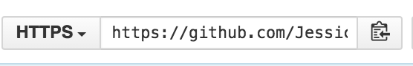
Let’s Clone Our First Repository
Step one: Let’s grab the https link from the GitHub repo

Slide 23
Let’s add another file from the command line

Slide 24
Let’s Clone Into Our First Repository
Step Two: Let’s clone the repository inside of our cloud 9 environment

Slide 25
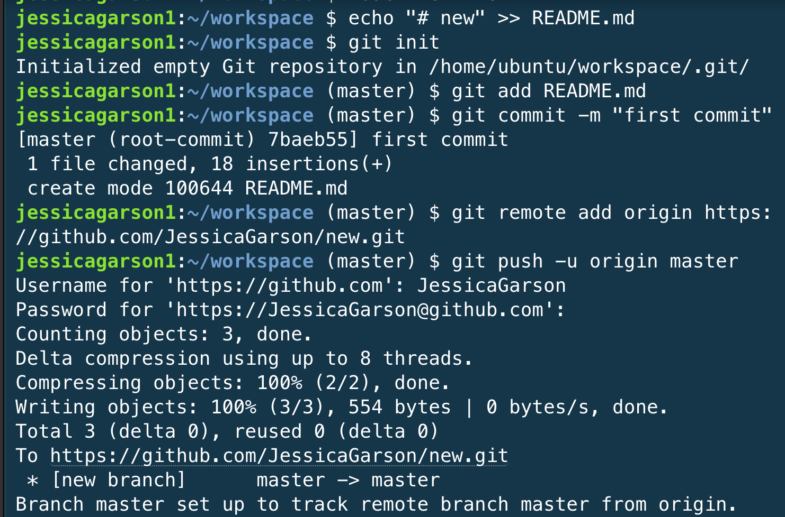
Creating a Repository From the Command Line

Slide 26
A few helpful commands in trouble shooting
git status - list’s the files you’ve changed and tells you what you have or haven’t committed
git diff – allows you to view all the merge conflicts
git branch – allows you to see all the branches and let’s you know which branch you are currently on

Slide 27
Let’s play around
Create a few text files
Add, commit, and push the files you create

Slide 28
Markdown – the language of communication
Markdown helps us communicate better with each other.
It is displays content as HTML
There is a GitHub flavored version of markdown

Slide 29
Let’s make our first markdown file
There is a sample profile in the folder titled “profile resources” in the repository of today’s class
There are two links that can be helpful as well in this profile
Let’s make our first markdown file

Slide 30
Let’s add our files to the main repository
Step one: Let’s clone our forked repo from earlier
Make sure you grab your html

Slide 31
Let’s add our files to the main repository
Step two: Clone your forked repo

Slide 32
Let’s add our files to the main repository
Step 3: Stage our file

Slide 33
Let’s add our files to the main repository
Step 4: Commit the file with a message

Slide 34
Let’s add our files to the main repository
Step 5: Commit the file with a message

Slide 35
Let’s add our files to the main repository
Step 5: Push the file

Slide 36
Submitting a pull request
Can we get one volunteer to come up to the front
We are going to log into GitHub, compare forks, and submit a pull request
Let’s all submit a pull request

Slide 37
Typical workflow of software teams
Usually new branches are created when one works on a project. You would usually create and checkout a new branch
From there you would add your files, stage them, commit and push to the branch

Slide 38
Do This at Home
Shell Environments
On a mac – there is a Linux environment that comes pre-installed called the terminal
To get to the terminal go to finder select utilities and inside the folder you should
On a PC – There are many options but I really like babun - http://babun.github.io/
Text Editors
Sublime Text - http://www.sublimetext.com/
Atom - https://atom.io/
Notepad ++ for PC only - https://notepad-plus-plus.org/

Slide 39






The coolest thing about DC right now

Slide 40
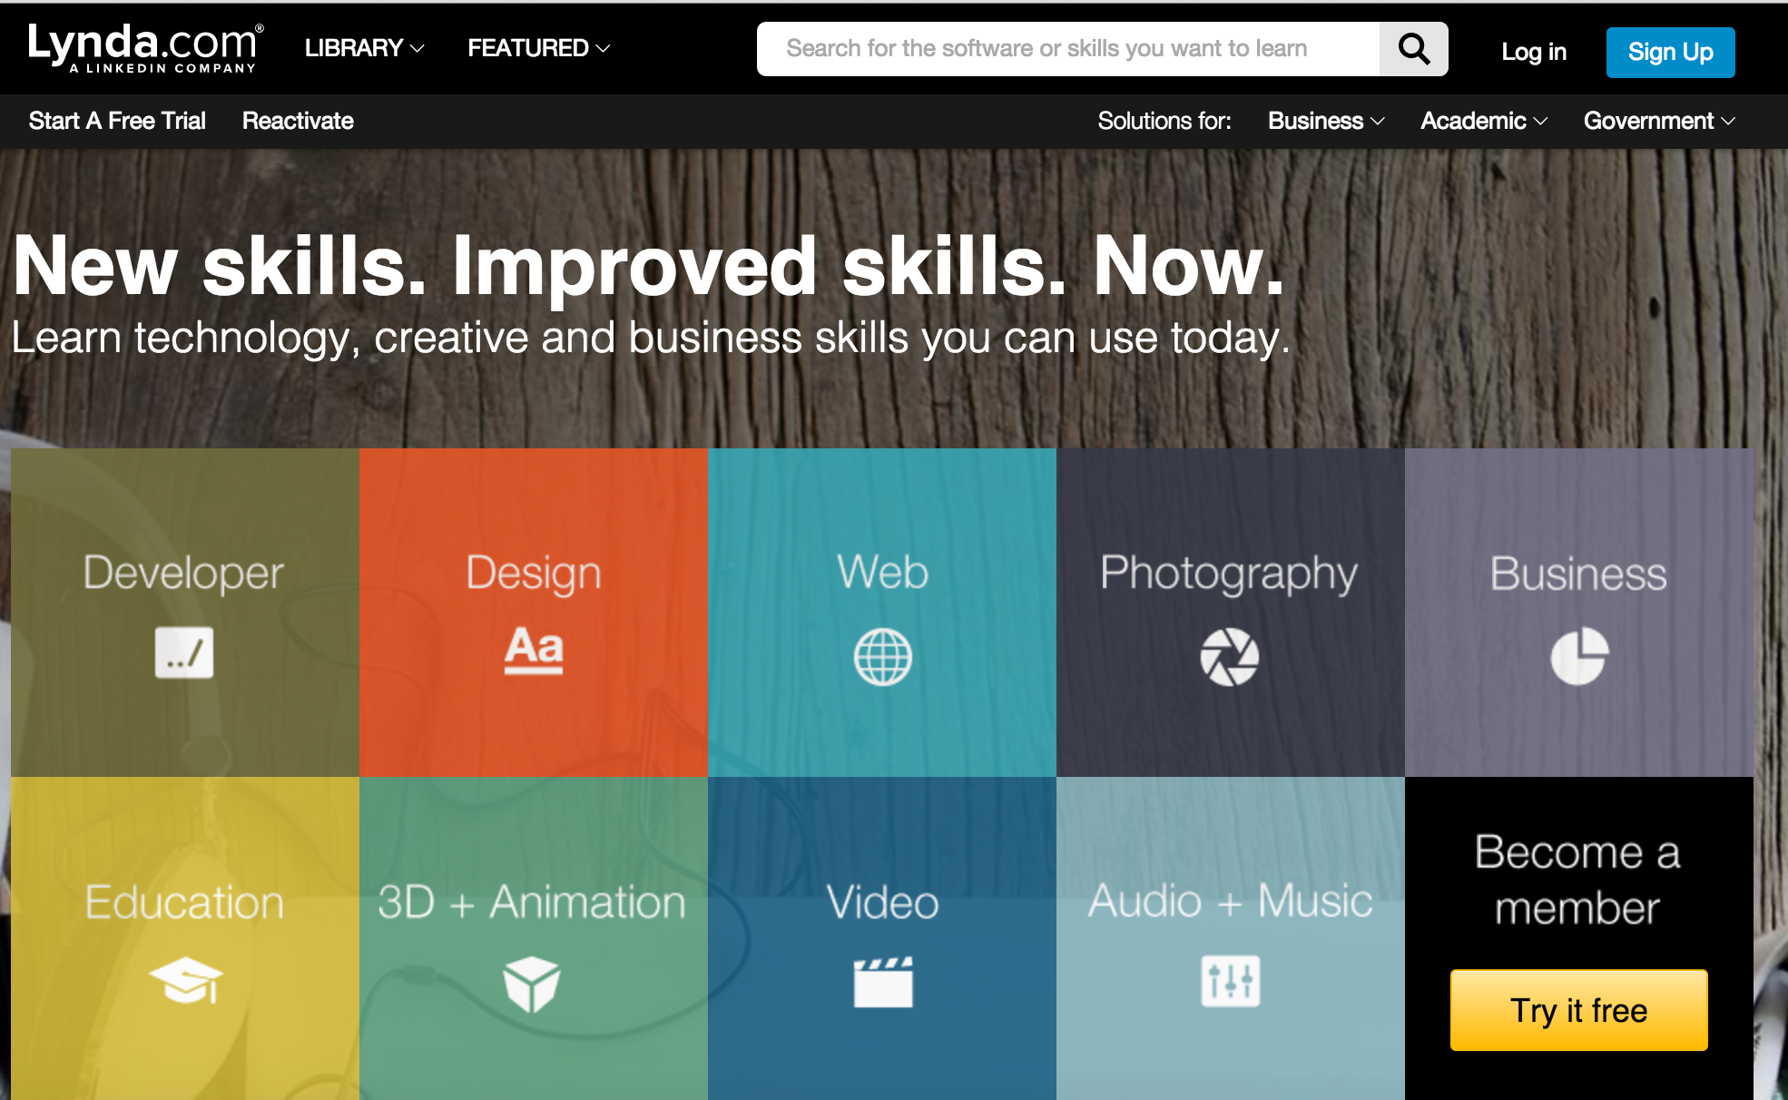
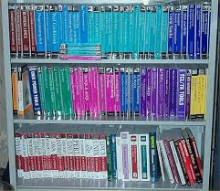
What Resources Does The Library Offer?

Slide 41
Other Classes in this Series

Slide 42
Questions, Comments, Feedback
Let us know if you have any

